Slide 1
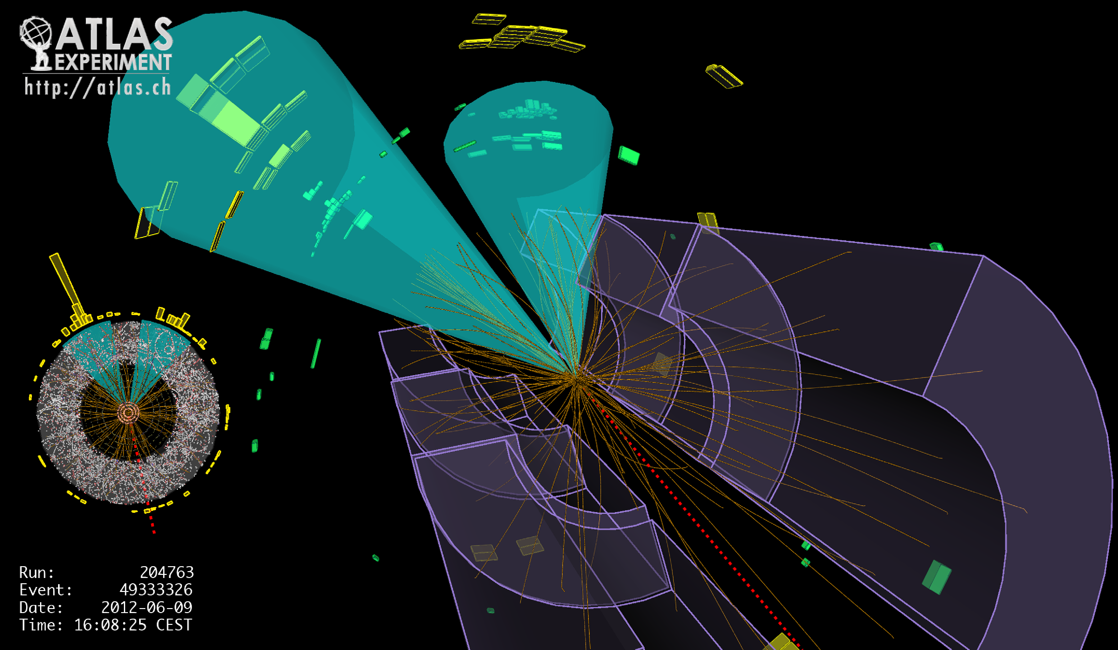
Lecture #9
Prof. Dr. Florencia Canelli
Universität Zürich
Elementary particle physics - PHY451
HS2016

Slide 2
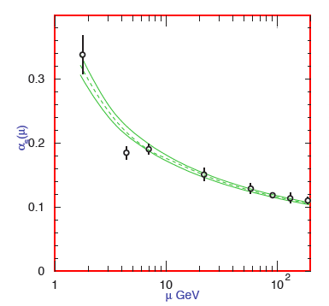
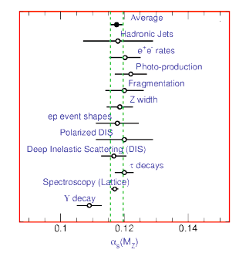
Implications (I) - running α_{s}
Experimentally tested
Different techniques agree at a single Q²
Most measurements done at the M_{z} scale with LEP data

Slide 3
Implications (I’) – perturbation
Since α_{s} is small at high Q², description of high Q² processes can be described perturbatively
In some cases the lowest order process is electromagnetic or weak
Higher order perturbative QCD corrections can be added to the basic process
Some processes (such as pp collisions) will be at the lowest order process QCD
Can also be done via perturbative corrections

Slide 4
Implications (II) - hadronization
Since α_{s} is large at low Q² quarks dress themselves as hadrons and on a time scale long compared to the hard scattering
Process of quarks and gluons turning into hadrons is called hadronization

Slide 5
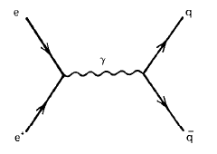
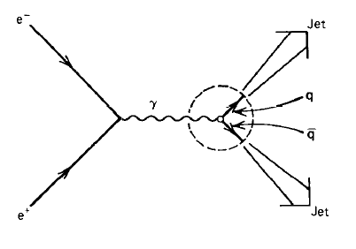
Implications (II) - hadronization
When a pair of quarks separates (~ 1 F)
Quick phenomenology: α_{s} becomes large, forces among the quarks become strong and decelerate the quarks radiating hadrons (mostly π) (bremsstrahlung)
Jets: a spray of hadrons hit the detector, traveling more or less in the same direction as the original quark
The verification of jets was crucial for the quark theory
Photon produced at rest by colliding electron and positrons can decay to a pair of quarks (more in a few slides)

Slide 6
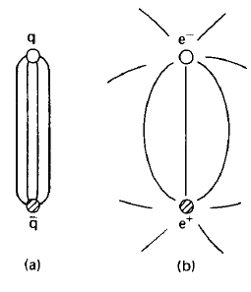
Implications (II) - hadronization
A more formal explanation
When a pair of quarks separates, creates a color dipole field
Color dipole looks different from electric dipole:
Lines in Coulomb field spread out V(r) ~ 1/r
Color field lines are squeezed into a tube like region
Instead of extending through all space, color dipole field flux tube has limited transverse extent
Lines in color field increase as V(r) ~k r
where k is a property of the QCD field (often called the “string tension")
Experimentally, k = 1 GeV/fm = 0.2 GeV⁻²
Later we will call this effect “parton shower” or fragmentation

Slide 7
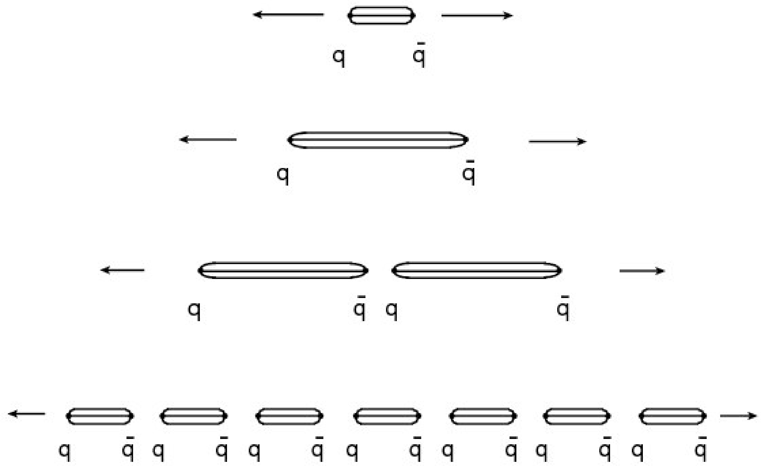
Implications (II) - hadronization
Lines are stretched until the increasing potential creates another quark pair
This process continues multiple times
Neighboring qq pairs combine to form hadrons
The production of particles is a random process which can occur anywhere along the color field
Quantum numbers are conserved locally in the pair production
Even more formally. The appearance of the quark pair is a quantum tunneling phenomenon: qq separate eating the color field and appear as physical particles
As the distance increases and Q² decreases, quarks become confined to hadrons
Scale for this confinement, hadronic mass scale: ~ few 100 MeV

Slide 8
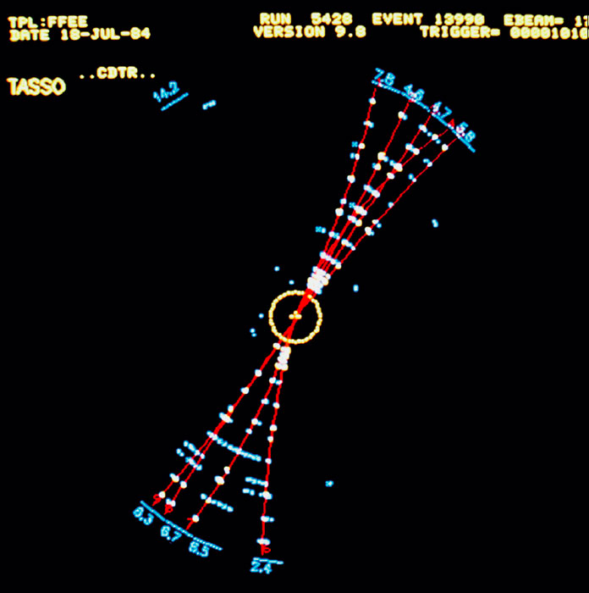
Implications (II) - hadronization
Experimental confirmation (Tasso experiment – Petra, DESY)
The probability for producing pair depends quark masses
Prob α e^{-m2/k}
relative rates of producing different flavors of quarks from the field are
u : d : s : c = 1 : 1 : 0:37 : 10⁻¹⁰
Limited momentum transverse to qq axis
As E_{cm} increases, the hadrons are more collimated: “jets"

Slide 9
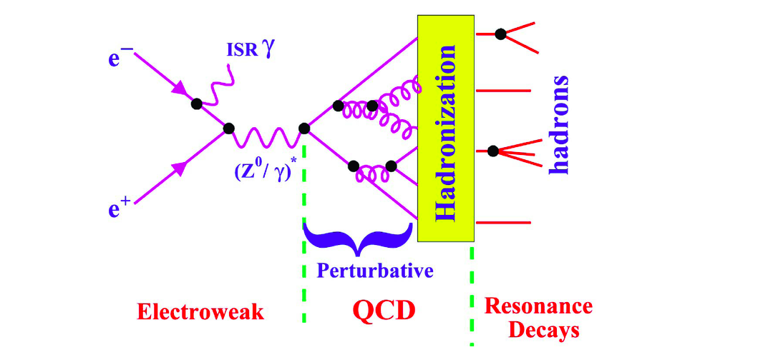
e⁺e⁻ to hadrons
Running of α_{s} means QCD description itself factorized
High Q² perturbative (calculable)
Low Q² hadronization (phenomenological model)
Lowest order hard scattering process is electroweak
Higher order needs QCD corrections

Slide 10
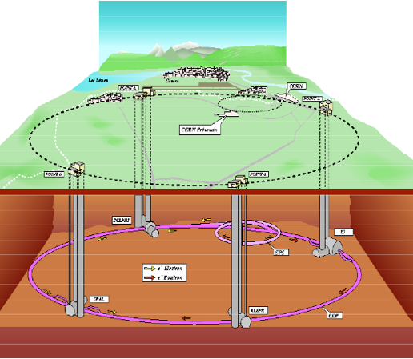
e⁺e⁻ colliders
An incomplete list :
SPEAR
DORIS
TRISTAN
PETRA
BEPC(-II)
DAPHNE
CESR
KEKB
PEP-II
LEP

Slide 11
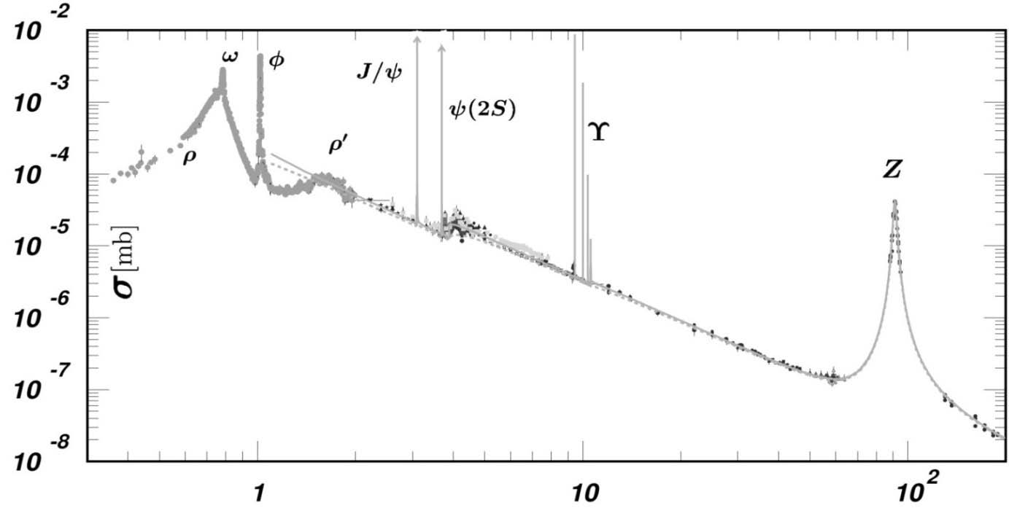
e⁺e⁻ colliders
LEP-1 & SLC
(1990’s)
PETRA & PEP
(1980’s)
discovery of gluon jets
First high energy jets
LEP-2
(1990’s)
SPEAR, SLAC
(1970’s)
discovery of quark jets
TRISTAN
(1990’s)

Slide 12
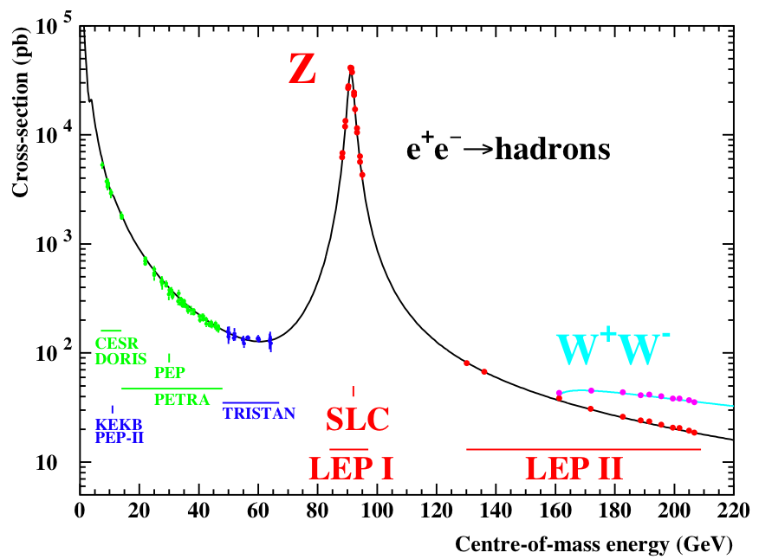
e⁺e⁻ colliders - LEP
The huge statistics (four million evts/experiment) has allowed a plethora of detailed studies of perturbative and non-perturbative QCD
Reliable calculations, smaller hadronic uncertainties
Precision tests of QCD

Slide 13
e⁺e⁻ to hadrons
Jets are clearly identified in today’s experiments, not the case for original experiments at low E_{cm}
The discovery of jet structure required a statistical analysis using a global metric
Many event-variables were defined to establish the observation and understanding of jets
Once the experimental E_{cm} increased, jets objects were defined using jet algorithms

Slide 14
From event variables to jets
SPEAR (SLAC): Since quarks have spin ½, events should not be spherical (sphericity)
Fixed-target pp experiments: study alignment of the collision, and collimation (thrust)
PETRA (DESY) and LEP (CERN): Study QCD corrections, extended sphericity and thrust families. Introduced clustering algorithms (JADE, Durham k_{T})
SppS (CERN): need to separate beam jets from high p_{T} jets. Introduce cone jets (and ~Durham clustering later) in (η,φ) space, e.g. UA1
Tevatron (Fermilab): mainly used cone algorithms
LHC (CERN): return of clustering with new safer and faster algorithms, anti-k_{T}

Slide 15
Event variable - Sphericity
Is the event spherical (as phase space would predict) or does it have a defined axis ?
Define Sphericity tensor
where the sum is over all the charged particles in the event
Define the 3 normalized eigenvalues
Define the sphericity S
The sphericity axis nS is defined along the direction of the the eigenvector associated with λ₁

Slide 16
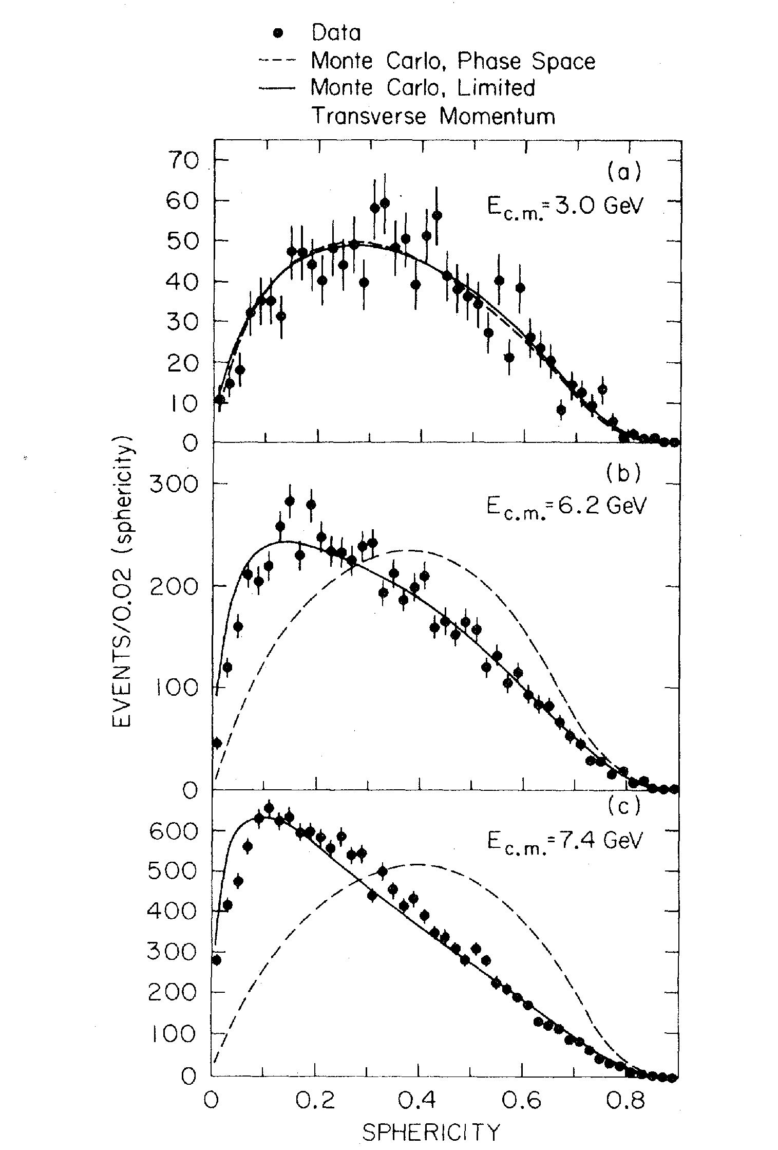
Jet structure - Sphericity
First observation of jet structure by studying sphericity distribution for different E_{cm}
Compare to a jet model and a phase space model
As E_{cm} increase, data becomes consistent with jet model
SLAC-LBL collaboration, G. Hanson et al, PLB 35 (1975) 1609

Slide 17

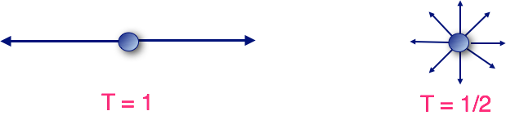
Event variable - Thrust
A linear alternative to sphericity
Introduced in 1978 by Petra/DESY
Thrust axis: vector n for which maximum longitudinal momentum is obtained

Slide 18
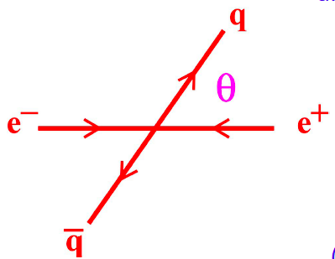
Quark spin - Thrust
Matrix element in the calculation of the cross section includes the spin information and prediction for the jet energies
Spin 1/2
Spin 0

Slide 19
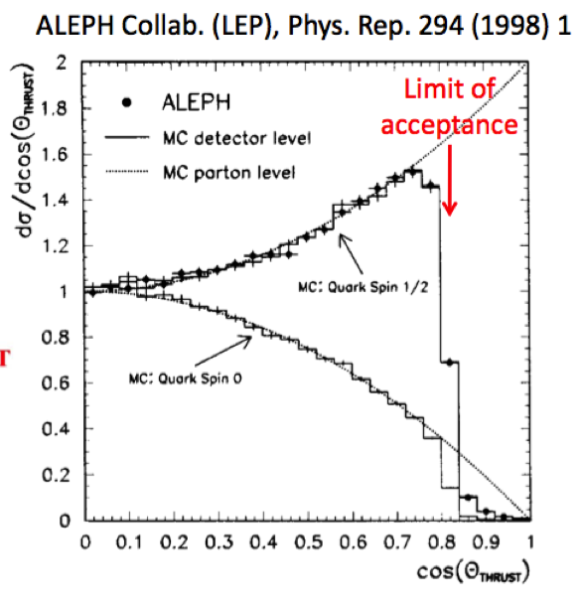
Quark spin - Thrust
To measure the quark direction we take the thrust direction
Then using the angle between the thrust axis and the beam, quarks have spin 1/2

Slide 20
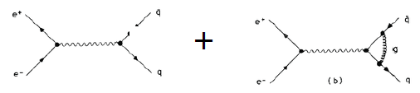


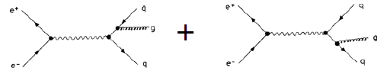
QCD corrections to e⁺e⁻ to hadrons
2-jet
2
3-jet
2
The 2 and 3 jet cross section diverge

Slide 21
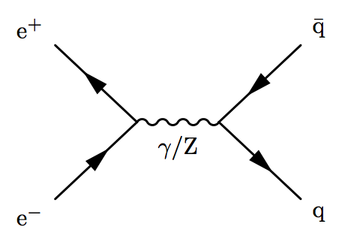
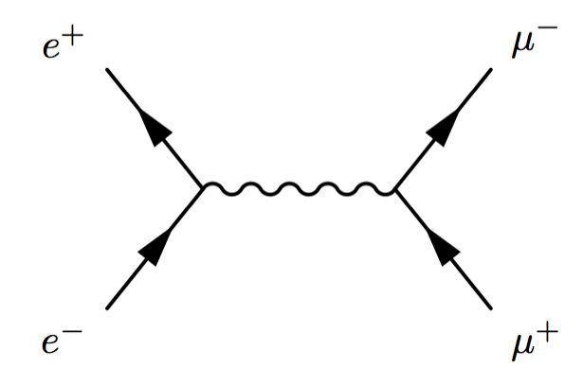
e⁺e⁻ to hadrons at tree level
2-jets (tree level), α⁰
Same graph as for muon pairs
But with fractional electrical charge for the quarks (smaller cross section)
And larger cross section by N_{c}=3

Slide 22
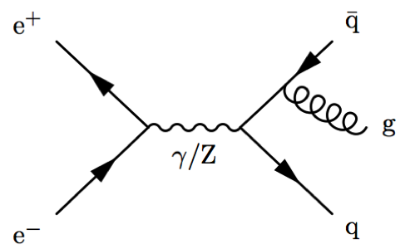
QCD corrections to e⁺e⁻ to hadrons
The energy fractions of the jets
Conservation of energy:
3-jets (leading order, LO – one loop), α¹
Singularities when
In practice we don’t know which is the q, q, g, so we order them in momentum (x₁, x₂, x₃)

Slide 23
Singularity Structure: “Dalitz Plot”

Slide 24
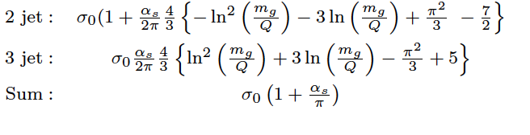
QCD corrections to e⁺e⁻ to hadrons
The divergences cancel out
Cancellation of infrared divergences is described using theorem by Kinoshita, Lee, Nauenberg

Slide 25
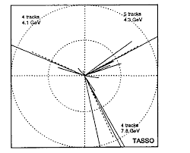
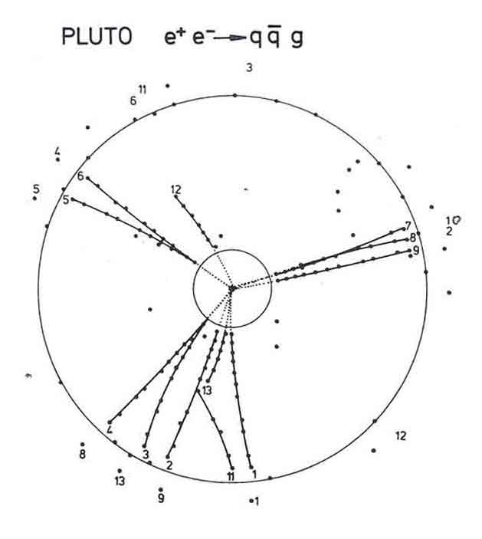
Discovery of gluon jets
Tasso, PLB 86(1979)243
First three jet event
Need event shape variables to interpret event

Slide 26
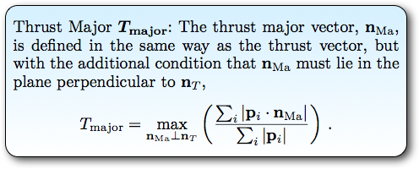
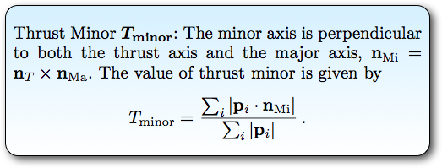
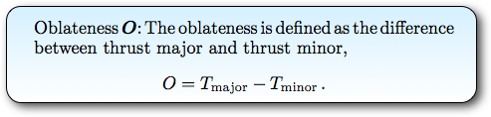
Thrust major and minor, Oblateness
Major and Oblateness are useful for identifying 3-jet structure
Minor for 4-jet ones

Slide 27
Event variable - Oblateness

Slide 28
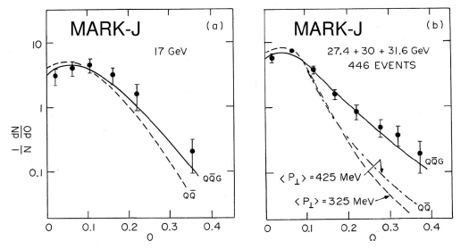
Back to gluon discovery
Oblateness
Events at E_{cm}~ 30 GeV show larger Oblateness (planar structure) than models without hard gluon radiation

Slide 29
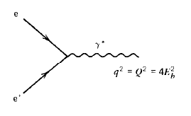
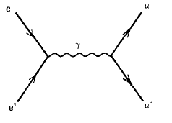
e⁺e⁻ annihilation to hadrons
Use high-resolution photons to study quarks by colliding electron and positrons
Clean process since involves leptons in the initial state
Instead of hadrons which have a complex structure (more in PPP2)
The QED process
With
E_{b} electron and positron beam energy

Slide 30
e⁺e⁻ annihilation to hadrons
The process
Its cross section
We take in account the fractional charge of the quark, e_{q}
N_{c} is the number of colors, 3
There is a diagram for each color, and they have to be added

Slide 31
e⁺e⁻ annihilation to hadrons
This leads us to the prediction
Since N_{C}=3 we have
for u,d,s
for u,d,s,c
for u,d,s,c,b
Above 3.1 GeV, charm pairs produced
Above 9.4 GeV, bottom pairs produced

Slide 32
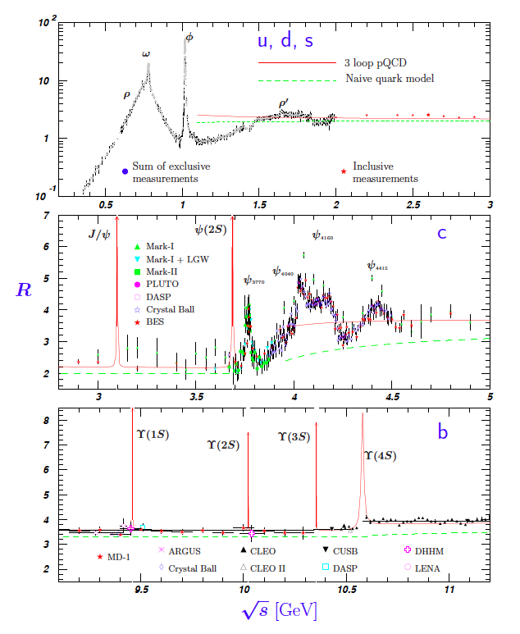
e⁺e⁻ annihilation to hadrons
These measurements confirm that there are 3 colors of quarks
R is modified when interpreted with QCD. It should include diagrams where one of the quarks radiate gluons
Will return to this in a couple of lectures

Slide 33
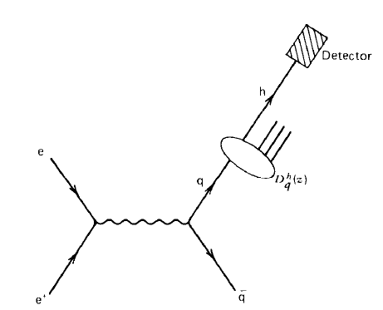
Quarks turn into hadrons
In the center of mass frame the quark and antiquark separate with equal and opposite momentum and materialize into two back to back jets which have momenta roughly collinear with the original q and q directions
How can we make predictions of observables after quarks hadronize ?
How can we represent the fragmentation and hadronization of quarks into hadrons ?

Slide 34
Describing hadronization
Suppose we want to describe
where h is a specific particle (eg pion)
Need probability that a q or q will fragment into h
Define D^{h}(z) a as probability that a quark q will fragment to form a hadron with measured energy E_{h}
Fraction of the energy z= E_{h}/E_{q} carries by the hadron
We cannot predict D^{h}(z)
Measure them in one process and then ask are they universal
These D^{h}(z) are essential for Monte Carlo programs, use to predict the hadron level output of a given experiment
We need to add the hadrons together to learn about the quarks and gluons they came from

Slide 35
From events to a physics result
Reminder on how we test predictions
Theory here
LHC produces events
Produce
events
Event generator
Observe
& store
events
Detector and data acquisition
Detector simulation
Event reconstruction
Jets to partons ?
Compare real
and simulated data
Physics analysis

Slide 36
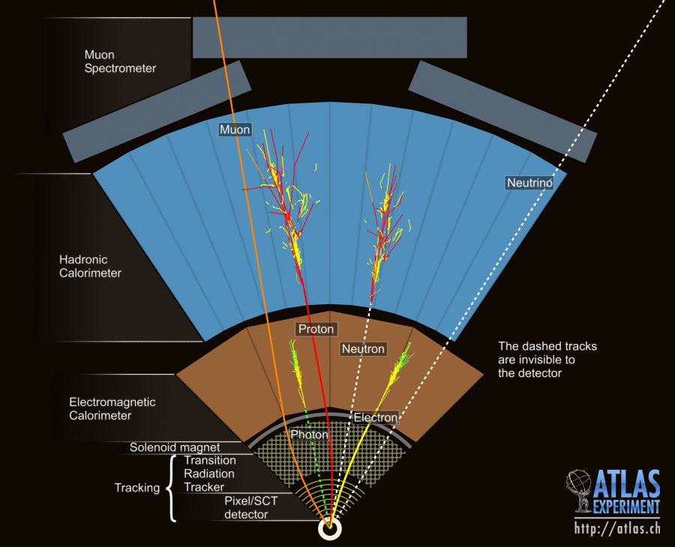
Measuring jets

Slide 37
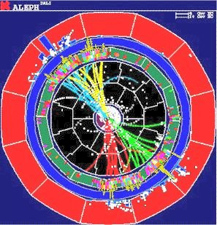
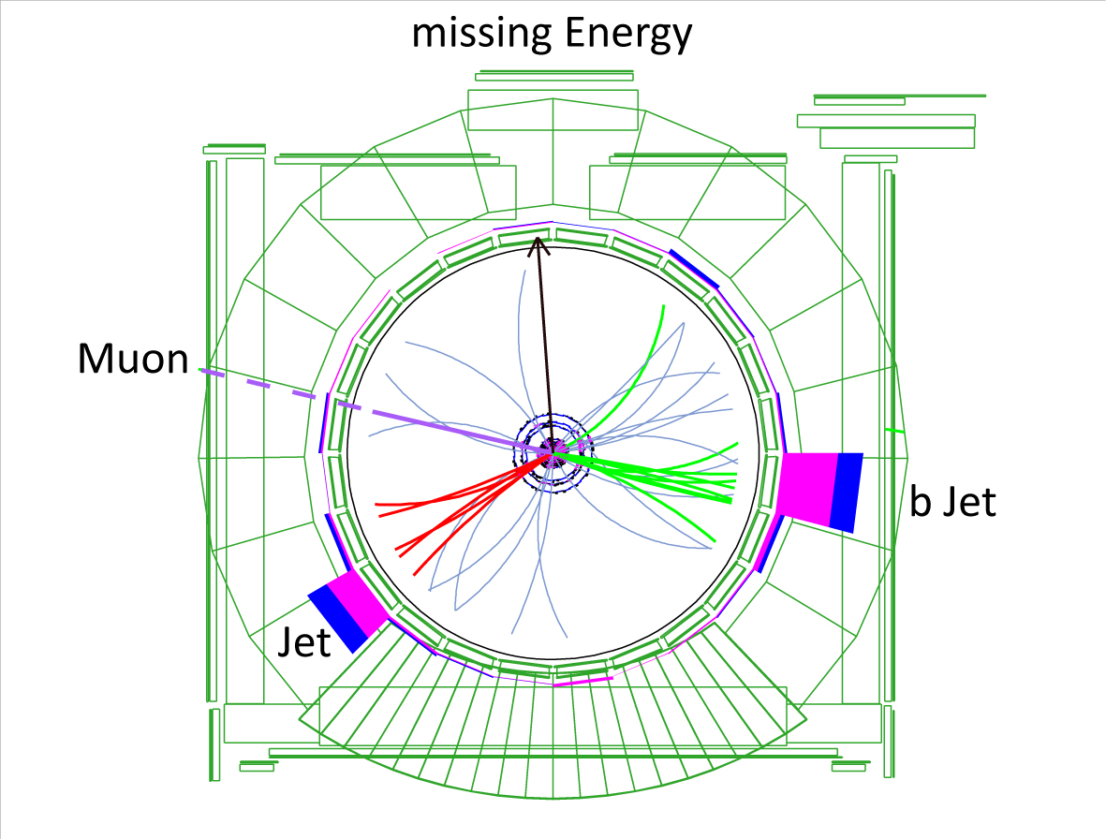
Jets in data

Slide 38
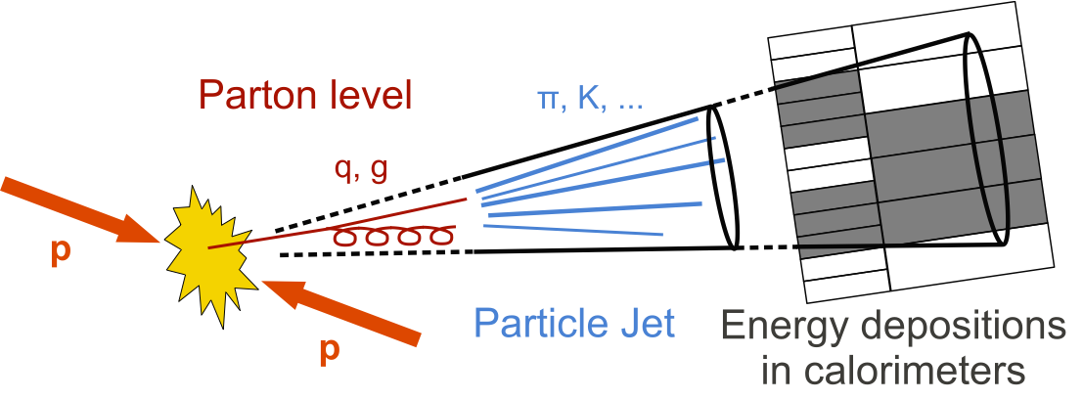
Measuring jets
Jets in the detector

Slide 39
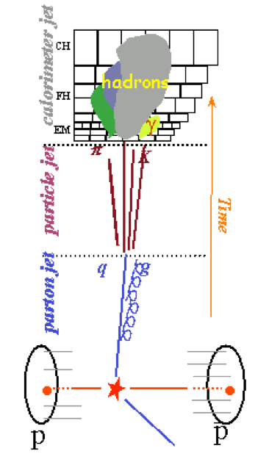
Jet algorithm
Jets: cluster/spray of particles (tracks, calorimeter deposits) of flow of energy in a restricted angular region
How to understand the jets we measure in terms of partons (quarks and gluons)
We need an algorithm definition of a jet which
Can be applied to both data and predictions
Gives a close relationship between partons and jets of hadrons
And
Should be applicable to parton, particle, measured objects jets for predictions and data
Should be independent of the detector used (experiment)

Slide 40
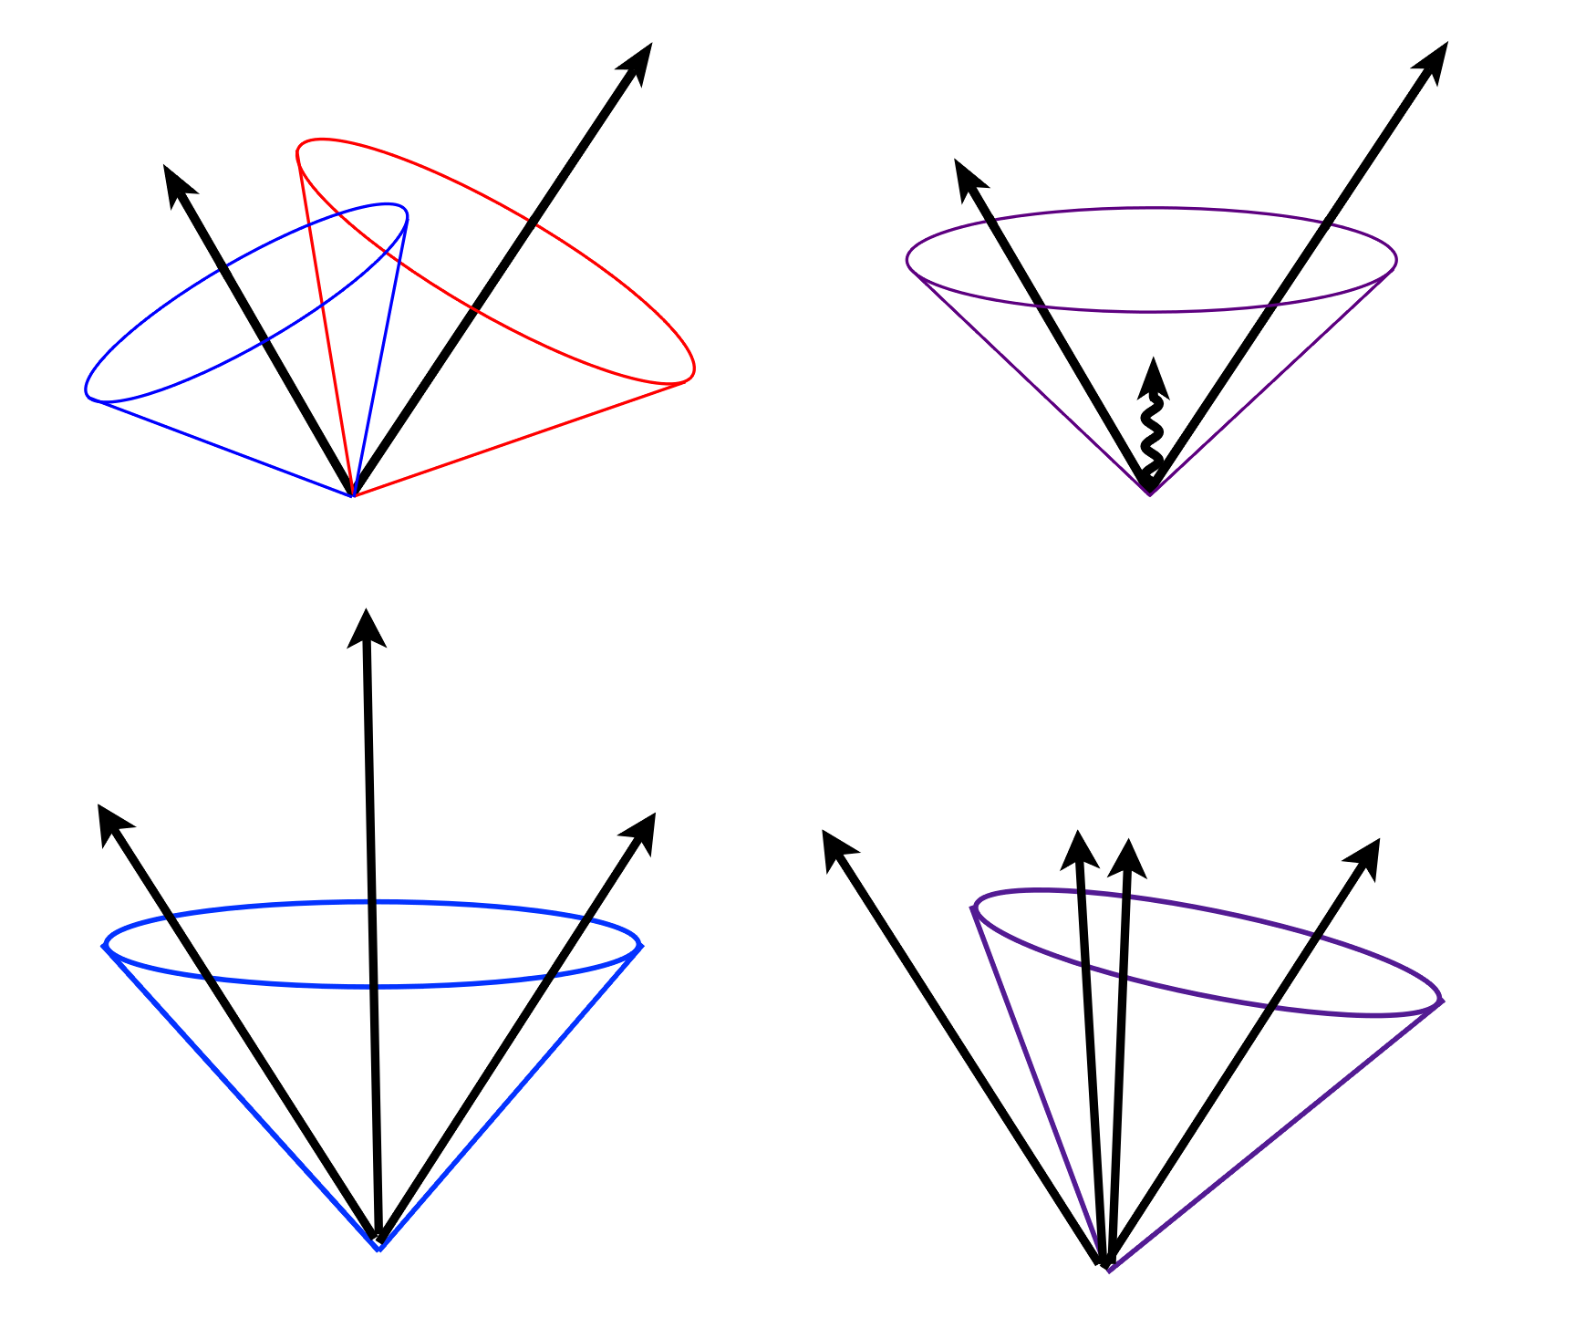
Jet algorithm requirements
Close correspondence between
P_{parton} P_{jet}
We want to compare perturbative calculations with data the algorithm has to be insensitive to “soft physics”
infra-red safety: configuration should not change when
adding a soft particle
collinear safety: configuration does not change when
substituing one particle with two collinear particle
This guarantee the cancellation (between real and
virtual emission diagrams) of the infrared and
collinear divergences in every order of perturbation
theory
Energy
Momentum
Angle

Slide 41
Examples of jet algorithms
There are two classes of jet algorithms
JADE
mainly used for e⁺e⁻ colliders
recently also at hadron colliders
will concentrate on this type here
CONE (Durham)
mainly used in hadron colliders
some applications also in e⁺e⁻
Both algorithms are infrared and collinear safe

Slide 42
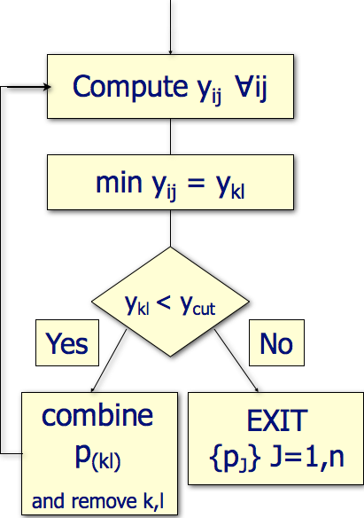
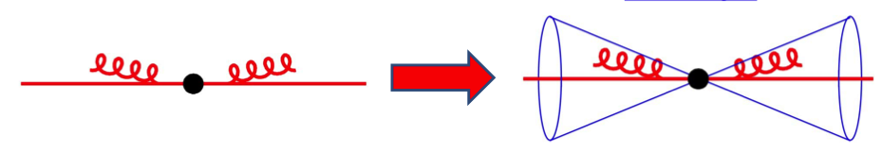
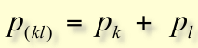
JADE algorithms
y_{ij} “metric” (measure of “distance” in momentum space)
Search for the smallest y_{ij}
Particles are parallel or very soft
If distances can not be resolved y_{ij} < y_{cut} particles are combined (clustered) into a new pseudo-particle with
i
j
m_{ij} invariant mass of the pair (i,j)
E-scheme

Slide 43
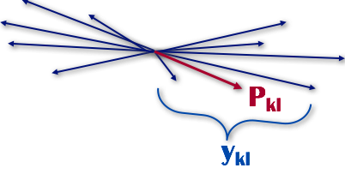
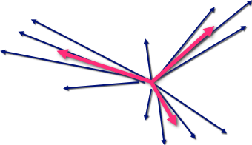
JADE algorithms
Reduce complex events until there is a certain number of jets

Slide 44
JADE algorithms
Characteristics of the algorithm:
All particles are assigned to only one jet
The algorithm sequence does not depend on y_{cut}
The number of jets is a monotonic function of y_{cut}

Slide 45
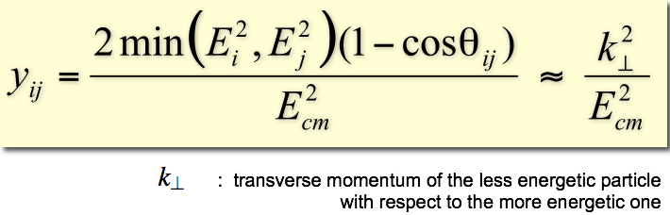
Durham algorithm
Another metric is used
Motivated by perturbative QCD calculations
Allows for the resummation of large logarithms of the type ln^{m}(y_{cut}) in all orders of perturbation theory. These logs appear order-by-order in the expressions for jet cross sections, jet rates etc.

Slide 46
Comparison of jet algorithms
The choice of algorithm depends on the performances and suitability in each analysis
Type of measurement, final signature, etc.
The benchmark points are
good resolution of energies and angles at parton, particle, and detector levels
good efficiency and purity to find a certain number of jets

Slide 47
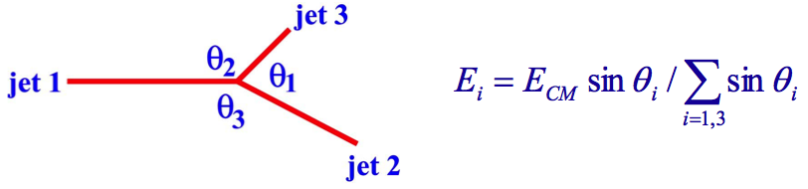
Gluon spin
Extraction of the gluon spin was done by selecting 3 jets events
~25% of the events with y_{cut} =0.02
Calculate the jet energies of the 3 jets
assume massless jets & E, p conservation
Order them by energy: E₁> E₂> E₃
jet 3 is the gluon jet in 75% of the events (energy tagging)
SLD collaboration (SLC), PRD55 (1997) 2533

Slide 48
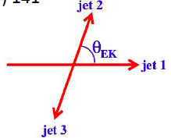
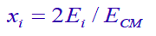
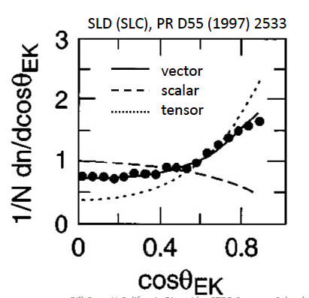
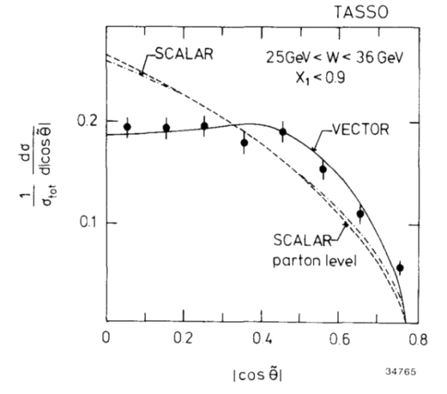
Gluon spin
Scale jet energies:
TASSO Collaboration (PETRA) PLB 97 (1980) 453

Slide 49
Differential 2-jet rate
Study the perturbative and non-perturbative transitions of QCD
Cluster jets using a given algorithm (e.g. Durham)
Find 3 jets and take the minimal y_{ij} among all combinations
The minimal distance = y₃
Gives one value per event
Plot the rate (cross section) as a function of y₃

Slide 50
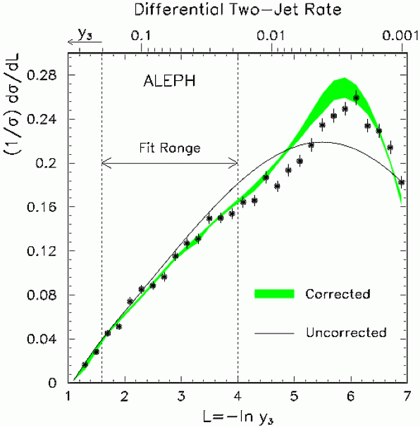


Differential 2-jet rate
For hadronic Z decays at LEP
Well described

Slide 51


Thrust in Z decay events
Thrust 1
Thrust 1/2

Slide 52

Thrust in differential 2-jet cross section
1/2
1
Hadronization Corrections from phenomenological models (string, cluster), implemented in Monte Carlo programs

Slide 53


Perturbative calculations
NLO: α² (1980-1990’s)
2-loop corrections to e⁺e⁻ to 2 jets
NLLA: Next-to-leading-log-approximation (1990’s)
Summation of collinear terms to all orders in α
NLO+NLLA: the standard at the end of LEP data-taking (2000)
NNLO: α³
3-loop corrections
Total e⁺e⁻ to hadrons cross section (1990’s)
Events shapes (thrust, etc.)
Current state of the art NNLO + matched NLLA (2008…)

Slide 54
Tuesday lectures
Date | Topic | Student
Sept 27 | Positron (p9) Muon (p29) Pion (p34) | Nici Alex Kevin
Oct 4 | Unstable particles (p65 or p71) Anti-p (p87) or Anti-n (p94) | Lukas Oliver
Oct 11 | Omega-(p144) Parity violation in beta (p163) Parity violation in pions (165) | Magnus Nici Alex
Oct 18 | K-long (p197) CP violation (p206) | Kevin Lukas
Oct 25 | Tau lepton J and Psi Charm meson | Oliver Magnus Nici
Nov 2 | Quarks SLAC Upsilon | Magnus Lukas
Date | Topic | Student
Nov 8 | Jets UA2 Gluons TASSO | Alex Kevin
Nov 15 | CLEO b Neutral currents Discovery of the W boson Neutrino types
Nov 22 | Discovery of the top quark Top quark mass measurement
Nov 29 | ARGUS CDF (or Belle/Babar)
Dec 6 | Solar Atmospheric
Dec 13
Dec 20 | Higgs discovery by ATLAS or CMS Measurements of Higgs boson properties
From pages from R. Cahn and G. Goldhaber book if available

